Slide 1
Breast Cancer Predictions
CS 675 Machine Learning
Milestone 4
Group:
Dhruvi Makadia
Maryana Stefanyshyn
Ashween Sudan

Slide 2
Table of Contents
01
02
03
KNN
Breast Cancer Predictions Dataset
Milestone 2 (Previous Work)
04
05
06
PCA
SVM
LINKS

Slide 3
Breast Cancer Wisconsin Data Set
Today, Breast cancer is the most common malignancy among women, accounting for nearly 1 in 3 cancers diagnosed among women in the United States, and it is the second leading cause of cancer death among women.
Breast Cancer occurs because of abnormal growth of cells in the breast tissue, commonly referred to as a Tumor. Tumors can be benign (not cancerous) or malignant (cancerous). Tests such as MRI, mammogram, ultrasound, and biopsy are commonly used to diagnose breast cancer performed.
The link to the dataset on Kaggle: https://www.kaggle.com/code/buddhiniw/breast-cancer-prediction/data.

Slide 4
Breast Cancer Wisconsin Data Set
Our goal is to classify a breast cancer tumor using two training classifications and predict if it is malignant or benign.
1 = Malignant (Cancer is present)
0 = Benign (Cancer is absent)
In Milestone 2, previous work has been done on the data set using Logistic Regression, Decision Trees and Random Forests.
For Milestone 4, our group has updated the dataset cancer predictions with 3 of the most useful Machine Learning algorithms : K Nearest Neighbours, PCA - Principal Component Analysis and SVM - Support Vector Machines

Slide 5
Milestone 2

Slide 6
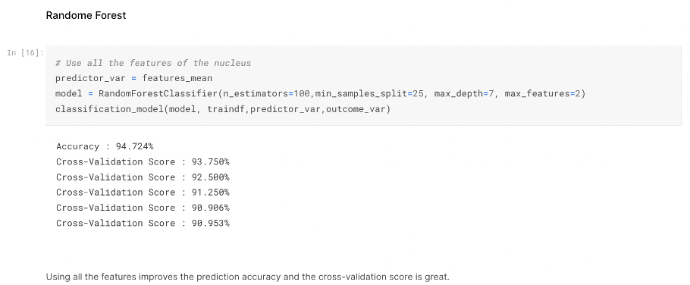
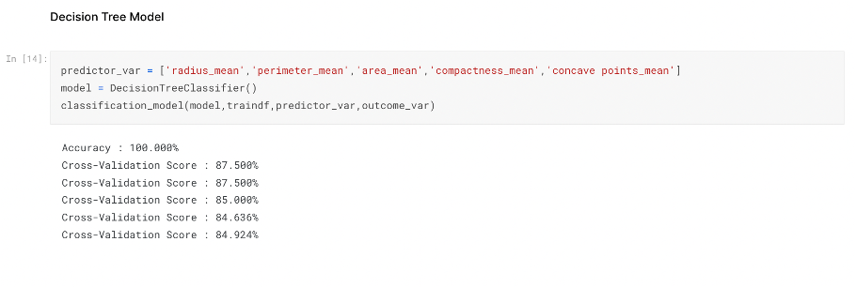
Previous Work
Breast Cancer Predictions by Buddhini Waidyawansa
Used the following predictive models
Logistic Regression
Decision Tree
Random Forest
Using Linear regression, she hypothesized that the cancer diagnosis depends on the mean cell radius, mean perimeter, mean area, mean compactness, mean concavity and mean concave points. Then, she performed logistic regression analysis using those features. According to her analysis she concluded that for now, the best model to be used for diagnosing breast cancer as found in this analysis is the Random Forest model with the top 5 predictors, 'concave points_mean','area_mean','radius_mean','perimeter_mean','concavity_mean'.

Slide 7
Milestone 4

Slide 8
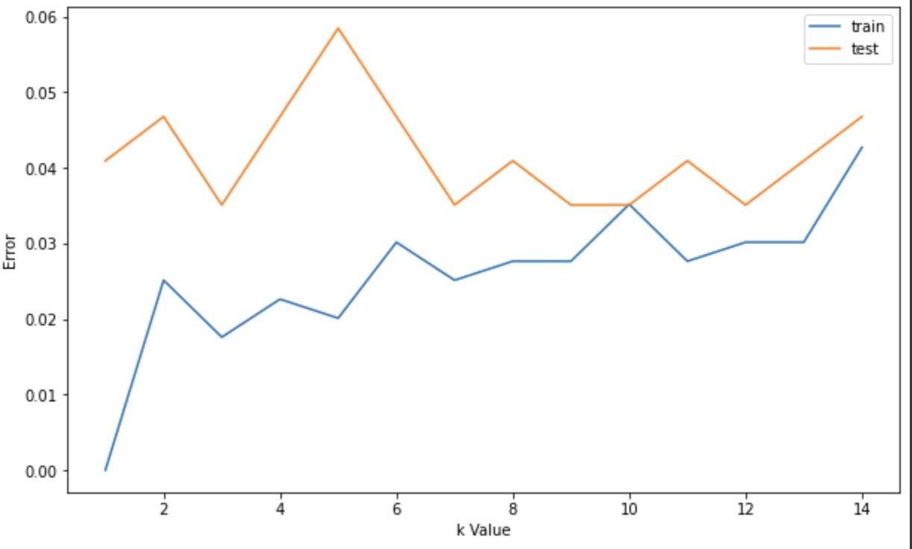
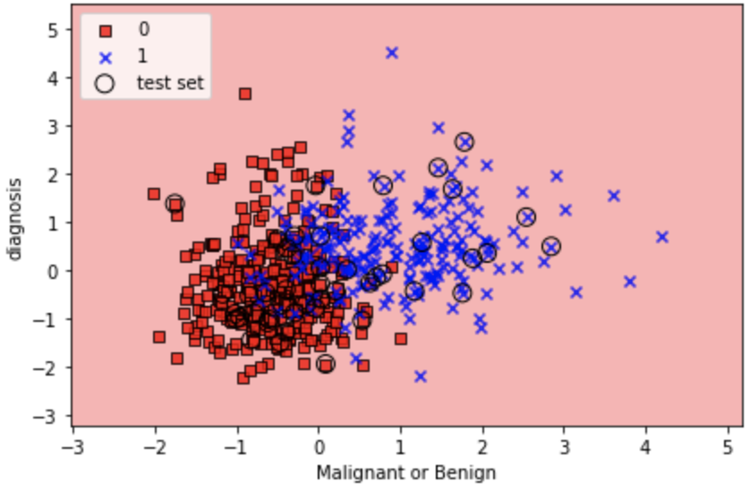
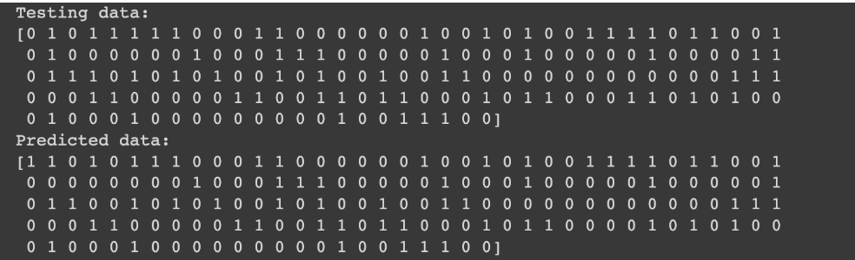
K Nearest Neighbors
The KNN Algorithm is an unsupervised learning algorithm that groups objects into clusters based on similarities.
First, we split the data into testing and training data and scaled it. We found 2 unique values (malignant and benign) from the “diagnosis” column in the dataset.
We graphed values of k vs. error to find k with the smallest error. From the graph, the best value of k between 9 and 10. We ran the KNN classifier and plotted the classification output. As presented in the graph, red represents “benign” and blue represents “malignant” cases. And we compared the testing data to predicted data.

Slide 9
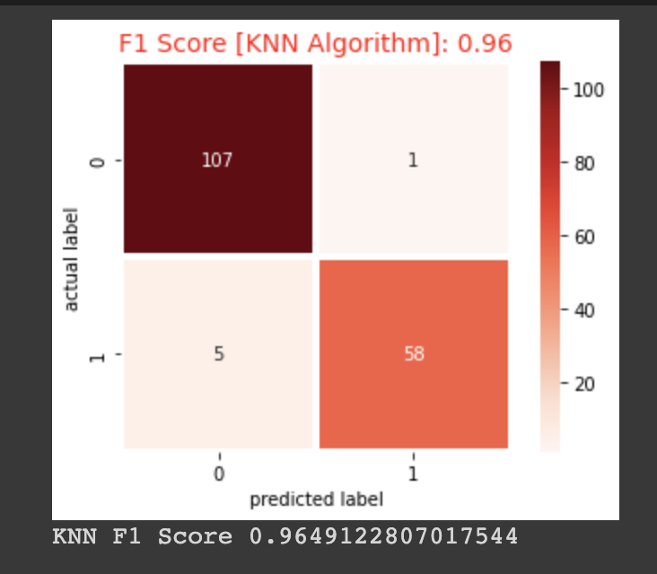
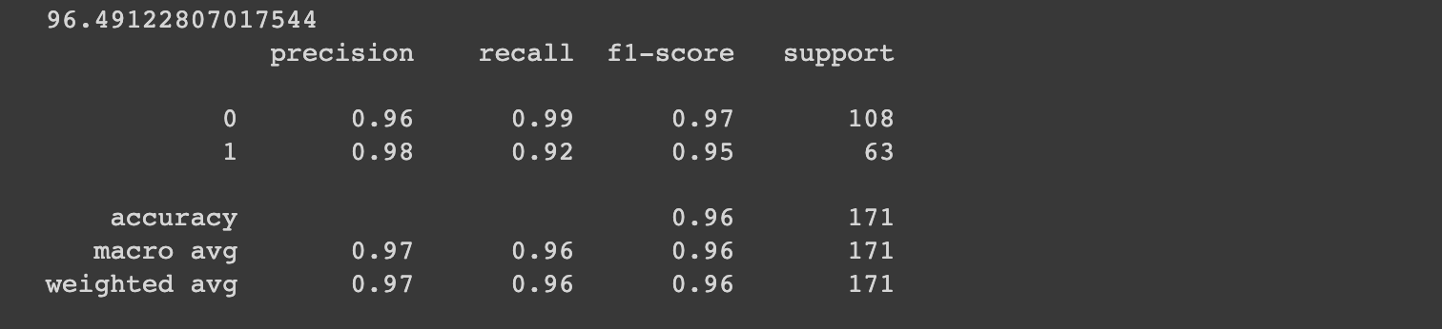
K Nearest Neighbors
The KNN Classifier made a total of 108 predictions. A total of 171 patients were being tested for the presence of breast cancer. Out of those 171 cases, the classifier predicted “1 = malignant” 63 times and “0=benign” 108 times. Therefore, 63 patients in the sample have the disease and 108 patients do not. The F1 score of KNN is 0.96 which is very good and shows high precision and accuracy of the algorithm.

Slide 10
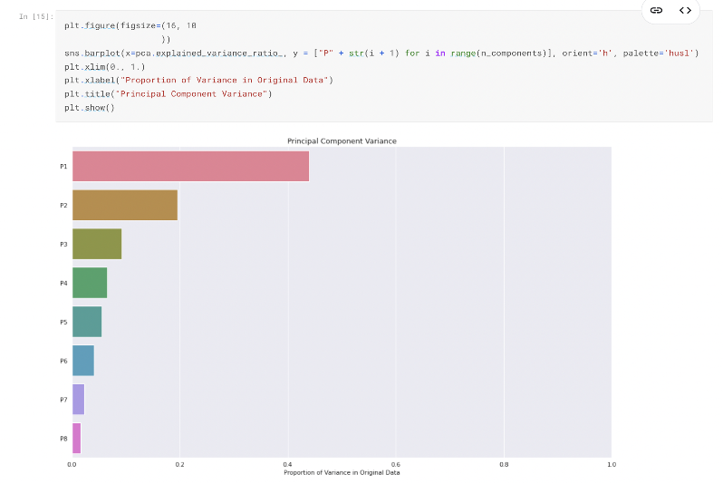
PCA Principal Component Analysis
PCA is a preprocessing step, which decomposes a multivariate dataset in a set of successive orthogonal components that explain a maximum amount of the variance.
It is used when we need to tackle datasets with a large number of features with different scales, some of which might be correlated. These correlations and the high dimension of the dataset bring a redundancy in the information.
Principal Component Analysis (PCA) is very useful to speed up the computation by reducing the dimensionality of the data. Plus, when you have high dimensionality with high correlated variable of one another, the PCA can improve the accuracy of classification model.

Slide 11
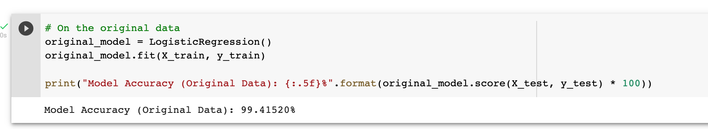
PCA Principal Component Analysis
PCA algorithm gives better accuracy when compared with SVM or KNeighbours.
Applying PCA, the original features are transformed into linear combinations of new independent variables, which reduce the complexity of the dataset and thus, the computational cost.
From our results, we found the PCA algorithm to be useful and give us an accuracy score of 99.41%.
Hence it can be used as an efficient application for detection and prevention of breast cancer.

Slide 12
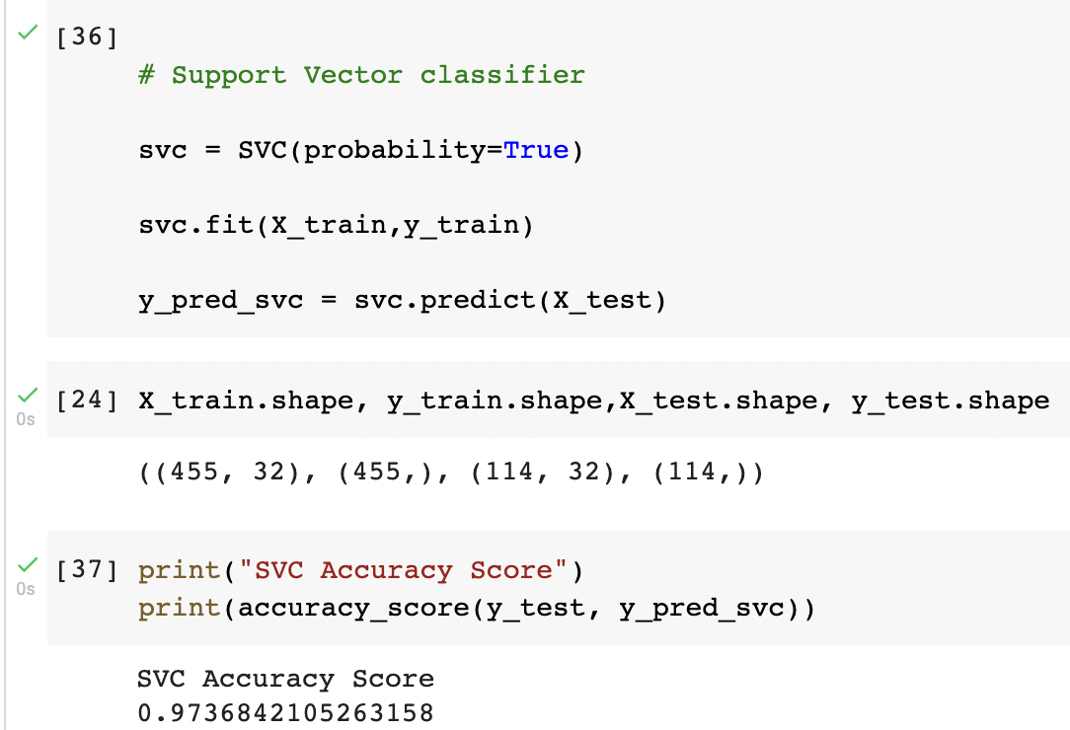
SVM Support Vector Machines
Support vector machine modeling is a promising classification approach for detecting a complex disease like cancer using common, simple variables. Validation indicated that the discriminative powers of our two SVM models are comparable to those of commonly used multivariable logistic regression methods.
With the use of SVM algorithm for detection of breast cancer tumor cells the algorithm gave us about 97.3% of accuracy score. which is almost near to the score we achieved through Decision tree model or PCA.
We split our data using 80% for training and the remaining 20% for testing .
The SVM classifier is being proved more efficient and accurate for the prediction and classification of the tumor into malignant(cancerous) and benign(non-cancerous) cells..

Slide 13
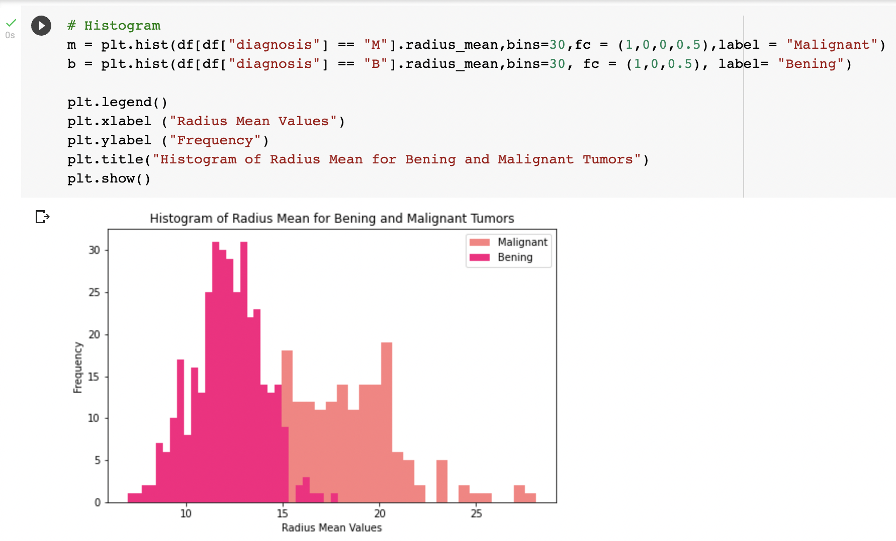
SVM Support Vector Machines
SVM's goal is to have largest possible margin between decision boundary that separates the classes and the training instances.
SVM is good for image analysis tasks, such as image classification and handwritten digit recognition. Also SVM is very effective in text-mining tasks, particularly due to its effectiveness in dealing with high-dimensional data.
The technique can rapidly evaluate breast masses and classify them in an automated fashion.
Our group performed a histogram as shown in the figure, for malignant and bening tumor cells.

Slide 14
Conclusion
Logistic Regression: 88.44%
Random Forest: 94.72%
Decision Tree: 100.00%
K Neighbors Classifiers: 96.49%
PCA: 99.41%
SVM: 97.36%
Looking at the overall accuracy, the Decision Tree Model had the highest accuracy score of 100%. However, that is very rare and means there can be overfitting of the data. Our analysis found the PCA model to have the next highest accuracy score of 99.41%.

Slide 15
Links/References
Link to the Breast Cancer Wisconsin (Diagnostic) Data Set:
https://www.kaggle.com/datasets/uciml/breast-cancer-wisconsin-data
Milestone 2 - Link to Buddhini Waidyawansa’s Breast Cancer Analysis:
https://www.kaggle.com/code/buddhiniw/breast-cancer-prediction/data.
Milestone 4 - Link to Our Group Report :
https://docs.google.com/document/d/16FYJwhcRCHDqehHolBOyq6vQs_6zZo4mU1pouiQL4Q8/edit#
Link to Breast Cancer Presentation (Google Powerpoint):
https://docs.google.com/presentation/d/1BELTxrqzIw4t4KIqzkZQvNX-hnufmG3CeeJB81SKKr4/edit#slide=id.p
Link to our Notebook and Source Code (Google Collab Notebook) :
https://colab.research.google.com/drive/1znLtJXpPd1tgUKO4Y_uH7qXZfyhXuHDB?authuser=2

Slide 16
THANK YOU

